Slide 1

STAT2201
STATISTICS or
(Probability and Statistics )
Lecture 1. PROBABILITY AND DISTRIBUTIONS
Bissembayev Alibek

Slide 2
Why Learn Probability?
Nothing in life is certain. In everything we do, we gauge the chances of successful outcomes, from business to medicine to the weather
A probability provides a quantitative description of the chances or likelihoods associated with various outcomes
It provides a bridge between descriptive and inferential statistics
Probability
Population
Sample
Statistics

Slide 3
Probabilistic vs Statistical Reasoning
Suppose I know exactly the proportions of car makes in Kostanay. Then I can find the probability that the first car I see in the street is a Sang Young. This is probabilistic reasoning as I know the population and predict the sample
Now suppose that I do not know the proportions of car makes in Kostanay, but would like to estimate them. I observe a random sample of cars in the street and then I have an estimate of the proportions of the population. This is statistical reasoning

Slide 4

What is Probability?
In Introduction, we used a descriptive measures to describe data sets which were usually samples.
We measured “how often” using
Relative frequency = f/n
As n gets larger,
Sample
And “How often”
= Relative frequency
Population
Probability

Slide 5
Basic Concepts
An experiment is the process by which an observation (or measurement) is obtained.
An event is an outcome of an experiment, usually denoted by a capital letter.
  The basic element to which probability is applied
  When an experiment is performed, a particular event either happens, or it doesn’t!

Slide 6
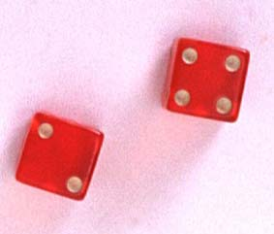
Experiments and Events
Experiment: Record an age
  A: person is 30 years old
  B: person is older than 65
Experiment: Toss a die
  A: observe an odd number
  B: observe a number greater than 2

Slide 7
Basic Concepts
Two events are mutually exclusive if, when one event occurs, the other cannot, and vice versa.
Experiment: Toss a die
  A: observe an odd number
  B: observe a number greater than 2
  C: observe a 6
  D: observe a 3
Not Mutually Exclusive
B and C?
B and D?
Mutually Exclusive

Slide 8
Basic Concepts
An event that cannot be decomposed is called a simple event.
Denoted by E with a subscript.
Each simple event will be assigned a probability, measuring “how often” it occurs.
The set of all simple events of an experiment is called the sample space, S.

Slide 9

Example
The die toss:
Simple events: Sample space:
1
E₁
E₂
E₃
E₄
E₅
E₆
S ={E₁, E₂, E₃, E₄, E₅, E₆}
2
S
3
E₁
E₃
4
E₅
5
E₂
E₆
E₄
6

Slide 10
Basic Concepts
An event is a collection of one or more simple events.
S
E₁
E₃
The die toss:
  A: an odd number
  B: a number > 2
A
E₅
B
E₂
E₆
E₄
A ={E₁, E₃, E₅}
B ={E₃, E₄, E₅, E₆}

Slide 11
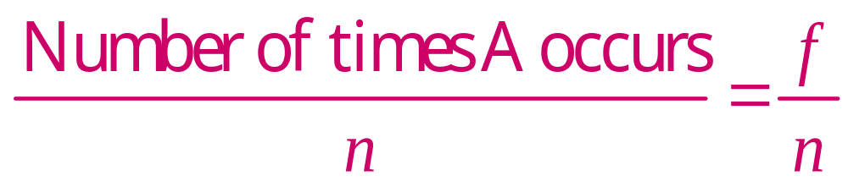
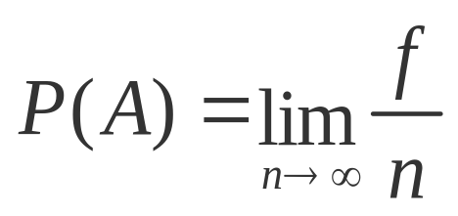
The Probability of an Event
The probability of an event A measures “how often” A will occur. We write P(A).
Suppose that an experiment is performed n times. The relative frequency for an event A is
If we let n get infinitely large,

Slide 12
The Probability of an Event
P(A) must be between 0 and 1.
  If event A can never occur, P(A) = 0. If event A always occurs when the experiment is performed, P(A) =1.
The sum of the probabilities for all simple events in S equals 1.
The probability of an event A is found by adding the probabilities of all the simple events contained in A.

Slide 13
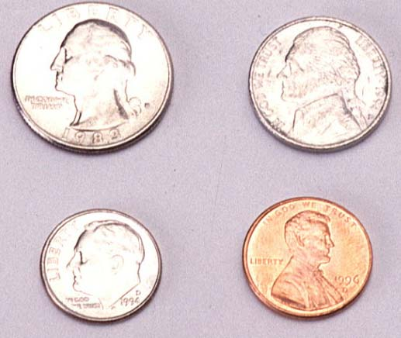
Finding Probabilities
Probabilities can be found using
  Estimates from empirical studies
  Common sense estimates based on equally likely events.
Examples:
  Toss a fair coin.
P(Head) = 1/2
Suppose that 10% of the U.S. population has red hair. Then for a person selected at random,
P(Red hair) = .10

Slide 14
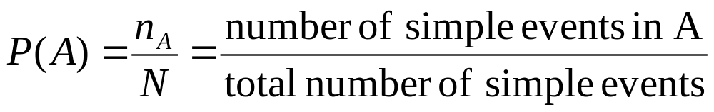
Using Simple Events
The probability of an event A is equal to the sum of the probabilities of the simple events contained in A
If the simple events in an experiment are equally likely, you can calculate

Slide 15
Example 1
Toss a fair coin twice. What is the probability of observing at least one head?
1st Coin 2nd Coin E_{i} P(E_{i})
H
HH
1/4
1/4
1/4
1/4
P(at least 1 head)
= P(E₁) + P(E₂) + P(E₃)
= 1/4 + 1/4 + 1/4 = 3/4
H
T
HT
H
TH
T
T
TT

Slide 16
Example 2
A bowl contains three M&Ms®, one red, one blue and one green. A child selects two M&Ms at random. What is the probability that at least one is red?
1st M&M 2nd M&M E_{i} P(E_{i})
m
RB
1/6
1/6
1/6
1/6
1/6
1/6
m
m
RG
P(at least 1 red)
= P(RB) + P(BR)+ P(RG) + P(GR)
= 4/6 = 2/3
m
BR
m
m
BG
m
GB
m
m
GR

Slide 17
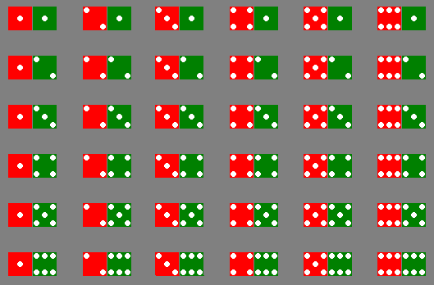
Example 3
The sample space of throwing a pair of dice is

Slide 18
Example 3
Event | Simple events | Probability
Dice add to 3 | (1,2),(2,1) | 2/36
Dice add to 6 | (1,5),(2,4),(3,3), (4,2),(5,1) | 5/36
Red die show 1 | (1,1),(1,2),(1,3), (1,4),(1,5),(1,6) | 6/36
Green die show 1 | (1,1),(2,1),(3,1), (4,1),(5,1),(6,1) | 6/36

Slide 19
Counting Rules
Sample space of throwing 3 dice has 216 entries, sample space of throwing 4 dice has 1296 entries, …
At some point, we have to stop listing and start thinking …
We need some counting rules

Slide 20

The mn Rule
If an experiment is performed in two stages, with m ways to accomplish the first stage and n ways to accomplish the second stage, then there are mn ways to accomplish the experiment.
This rule is easily extended to k stages, with the number of ways equal to
  n₁ n₂ n₃ … n_{k}
Example: Toss two coins. The total number of simple events is:
2 × 2 = 4

Slide 21

Examples
m
Example: Toss three coins. The total number of simple events is:
m
2 × 2 × 2 = 8
Example: Toss two dice. The total number of simple events is:
6 × 6 = 36
Example: Toss three dice. The total number of simple events is:
6 × 6 × 6 = 216
Example: Two M&Ms are drawn from a dish containing two red and two blue candies. The total number of simple events is:
4 × 3 = 12

Slide 22

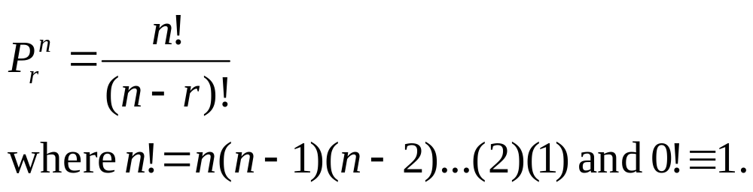
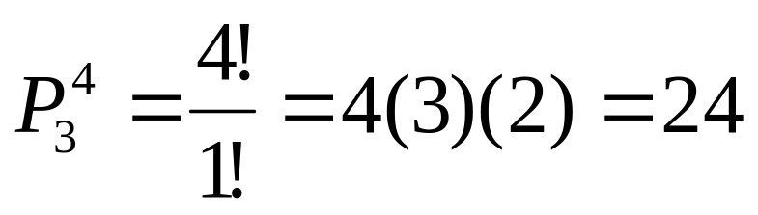
Permutations
The number of ways you can arrange
n distinct objects, taking them r at a time is
Example: How many 3-digit lock combinations can we make from the numbers 1, 2, 3, and 4?
The order of the choice is important!

Slide 23
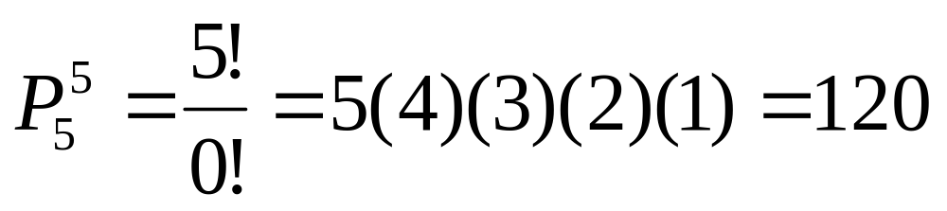
Examples
Example: A lock consists of five parts and can be assembled in any order. A quality control engineer wants to test each order for efficiency of assembly. How many orders are there?
The order of the choice is important!

Slide 24
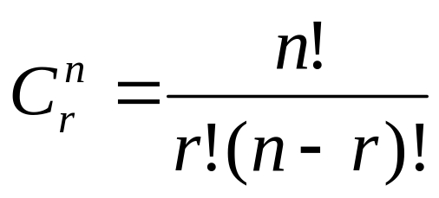
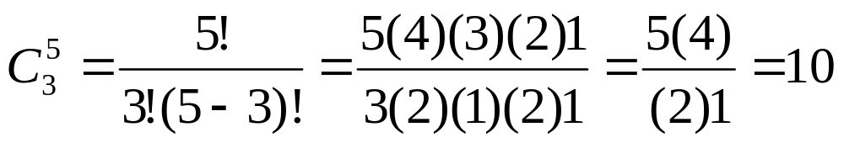
Combinations
The number of distinct combinations of n distinct objects that can be formed, taking them r at a time is
Example: Three members of a 5-person committee must be chosen to form a subcommittee. How many different subcommittees could be formed?
The order of
the choice is
not important!

Slide 25
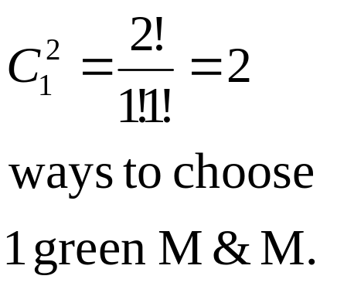
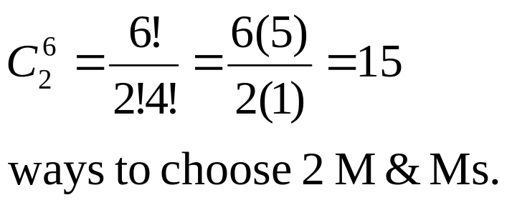
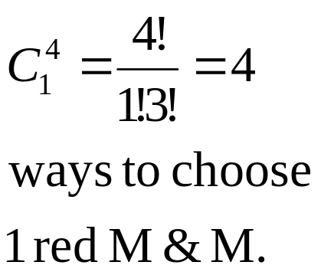
Example
m
m
m
m
m
m
A box contains six M&Ms®, four red
and two green. A child selects two M&Ms at random. What is the probability that exactly one is red?
The order of
the choice is
not important!
4 × 2 =8 ways to choose 1 red and 1 green M&M.
P(exactly one red) = 8/15

Slide 26


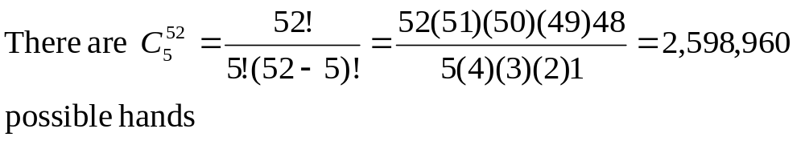
Example
A deck of cards consists of 52 cards, 13 "kinds" each of four suits (spades, hearts, diamonds, and clubs). The 13 kinds are Ace (A), 2, 3, 4, 5, 6, 7, 8, 9, 10, Jack (J), Queen (Q), King (K). In many poker games, each player is dealt five cards from a well shuffled deck.

Slide 27
Example
Four of a kind: 4 of the 5 cards are the same “kind”. What is the probability of getting four of a kind in a five card hand?
There are 13 possible choices for the kind of which to have four, and 52-4=48 choices for the fifth card. Once the kind has been specified, the four are completely determined: you need all four cards of that kind. Thus there are 13×48=624 ways to get four of a kind.
The probability=624/2598960=.000240096
and

Slide 28
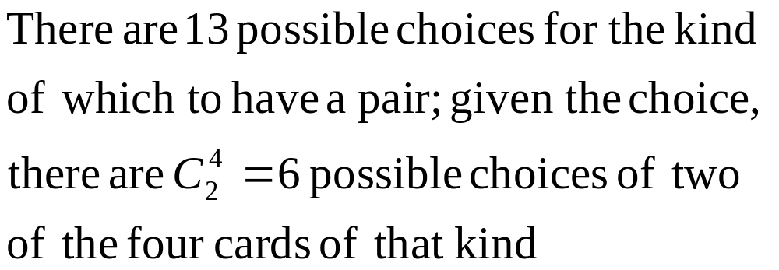
Example
One pair: two of the cards are of one kind, the other three are of three different kinds.
What is the probability of getting one pair in a five card hand?

Slide 29
Example
There are 12 kinds remaining from which to select the other three cards in the hand. We must insist that the kinds be different from each other and from the kind of which we have a pair, or we could end up with a second pair, three or four of a kind, or a full house.

Slide 30
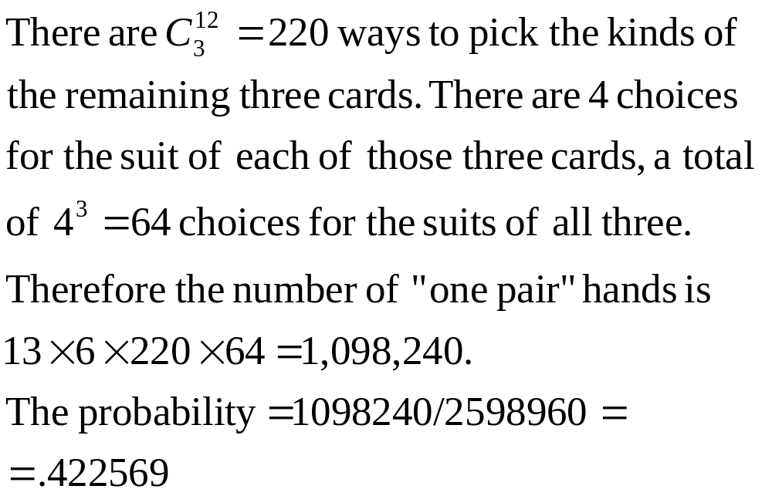
Example

Slide 31

Event Relations
The beauty of using events, rather than simple events, is that we can combine events to make other events using logical operations: and, or and not.
The union of two events, A and B, is the event that either A or B or both occur when the experiment is performed. We write
A ∪ B
S
A
B

Slide 32

Event Relations
The intersection of two events, A and B, is the event that both A and B occur when the experiment is performed. We write A ∩ B.
S
A
B
If two events A and B are mutually exclusive, then P(A ∩ B) = 0.

Slide 33
Event Relations
The complement of an event A consists of all outcomes of the experiment that do not result in event A. We write A^{C}.
S
A^{C}
A

Slide 34

Example
Select a student from the classroom and
record his/her hair color and gender.
  A: student has brown hair
  B: student is female
  C: student is male
Mutually exclusive; B = C^{C}
What is the relationship between events B and C?
A^{C}:
B∩C:
B∪C:
Student does not have brown hair
Student is both male and female = ∅
Student is either male and female = all students = S

Slide 35
Calculating Probabilities for Unions and Complements
There are special rules that will allow you to calculate probabilities for composite events.
The Additive Rule for Unions:
For any two events, A and B, the probability of their union, P(A ∪ B), is
A
B

Slide 36

Example: Additive Rule
Example: Suppose that there were 120 students in the classroom, and that they could be classified as follows:
A: brown hair
P(A) = 50/120
B: female
P(B) = 60/120
 | Brown | Not Brown
Male | 20 | 40
Female | 30 | 30
P(A∪B) = P(A) + P(B) – P(A∩B)
= 50/120 + 60/120 - 30/120
= 80/120 = 2/3
Check: P(A∪B)
= (20 + 30 + 30)/120

Slide 37
Example: Two Dice
A: red die show 1
B: green die show 1
P(A∪B) = P(A) + P(B) – P(A∩B)
= 6/36 + 6/36 – 1/36
= 11/36

Slide 38

A Special Case
When two events A and B are mutually exclusive, P(A∩B) = 0
and P(A∪B) = P(A) + P(B).
A: male with brown hair
P(A) = 20/120
B: female with brown hair
P(B) = 30/120
 | Brown | Not Brown
Male | 20 | 40
Female | 30 | 30
P(A∪B) = P(A) + P(B)
= 20/120 + 30/120
= 50/120
A and B are mutually exclusive, so that

Slide 39
Example: Two Dice
A: dice add to 3
B: dice add to 6
P(A∪B) = P(A) + P(B)
= 2/36 + 5/36
= 7/36
A and B are mutually exclusive, so that

Slide 40
Calculating Probabilities for Complements
A^{C}
A
We know that for any event A:
  P(A ∩ A^{C}) = 0
Since either A or A^{C} must occur,
  P(A ∪ A^{C}) =1
so that P(A ∪ A^{C}) = P(A)+ P(A^{C}) = 1
P(A^{C}) = 1 – P(A)

Slide 41

Example
Select a student at random from the classroom. Define:
A: male
P(A) = 60/120
B: female
P(B) = ?
 | Brown | Not Brown
Male | 20 | 40
Female | 30 | 30
A and B are complementary, so that
P(B) = 1- P(A)
= 1- 60/120 = 60/120

Slide 42
Calculating Probabilities for Intersections
In the previous example, we found P(A ∩ B) directly from the table. Sometimes this is impractical or impossible. The rule for calculating P(A ∩ B) depends on the idea of independent and dependent events.
Two events, A and B, are said to be independent if the occurrence or nonoccurrence of one of the events does not change the probability of the occurrence of the other event.

Slide 43
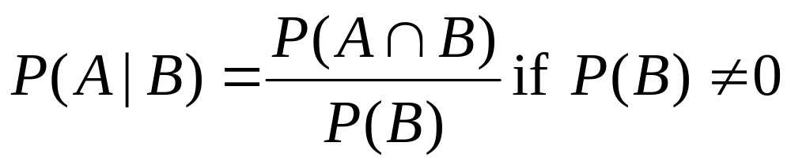
Conditional Probabilities
The probability that A occurs, given that event B has occurred is called the conditional probability of A given B and is defined as
“given”

Slide 44
Example 1
Toss a fair coin twice. Define
  A: head on second toss
  B: head on first toss
P(A|B) = ½
P(A|not B) = ½
HH
1/4
1/4
1/4
1/4
HT
P(A) does not change, whether B happens or not…
A and B are independent!
TH
TT

Slide 45
Example 2
A bowl contains five M&Ms®, two red and three blue. Randomly select two candies, and define
  A: second candy is red.
  B: first candy is blue.
m
P(A|B) =P(2nd red|1st blue)= 2/4 = 1/2
P(A|not B) = P(2nd red|1st red) = 1/4
m
m
m
m
P(A) does change, depending on whether B happens or not…
A and B are dependent!

Slide 46
Example 3: Two Dice
Toss a pair of fair dice. Define
  A: red die show 1
  B: green die show 1
P(A|B) = P(A and B)/P(B)
=1/36/1/6=1/6=P(A)
P(A) does not change, whether B happens or not…
A and B are independent!

Slide 47
Example 3: Two Dice
Toss a pair of fair dice. Define
  A: add to 3
  B: add to 6
P(A|B) = P(A and B)/P(B)
=0/36/5/6=0
P(A) does change when B happens
A and B are dependent! In fact, when B happens, A can’t

Slide 48
Defining Independence
We can redefine independence in terms of conditional probabilities:
Two events A and B are independent if and only if
P(A|B) = P(A) or P(B|A) = P(B)
Otherwise, they are dependent.
Once you’ve decided whether or not two events are independent, you can use the following rule to calculate their intersection.

Slide 49
The Multiplicative Rule for Intersections
For any two events, A and B, the probability that both A and B occur is
P(A ∩ B) = P(A) P(B given that A occurred) = P(A)P(B|A)
If the events A and B are independent, then the probability that both A and B occur is
P(A ∩ B) = P(A) P(B)

Slide 50

Example 1
In a certain population, 10% of the people can be
classified as being high risk for a heart attack. Three people are randomly selected from this population. What is the probability that exactly one of the three are high risk?
Define H: high risk N: not high risk
P(exactly one high risk) = P(HNN) + P(NHN) + P(NNH)
= P(H)P(N)P(N) + P(N)P(H)P(N) + P(N)P(N)P(H)
= (.1)(.9)(.9) + (.9)(.1)(.9) + (.9)(.9)(.1)= 3(.1)(.9)² = .243

Slide 51
Example 2
Suppose we have additional information in the
previous example. We know that only 49% of the population are female. Also, of the female patients, 8% are high risk. A single person is selected at random. What is the probability that it is a high risk female?
Define H: high risk F: female
From the example, P(F) = .49 and P(H|F) = .08. Use the Multiplicative Rule:
P(high risk female) = P(H∩F)
= P(F)P(H|F) =.49(.08) = .0392

Slide 52
The Law of Total Probability
Let S₁ , S₂ , S₃ ,..., S_{k} be mutually exclusive and exhaustive events (that is, one and only one must happen). Then the probability of any event A can be written as
P(A) = P(A ∩ S₁) + P(A ∩ S₂) + … + P(A ∩ S_{k})
= P(S₁)P(A|S₁) + P(S₂)P(A|S₂) + … + P(S_{k})P(A|S_{k})

Slide 53
The Law of Total Probability
S₁
A
A ∩S_{k}
A ∩ S₁
S_{k}
S_{2….}
P(A) = P(A ∩ S₁) + P(A ∩ S₂) + … + P(A ∩ S_{k})
= P(S₁)P(A|S₁) + P(S₂)P(A|S₂) + … + P(S_{k})P(A|S_{k})

Slide 54
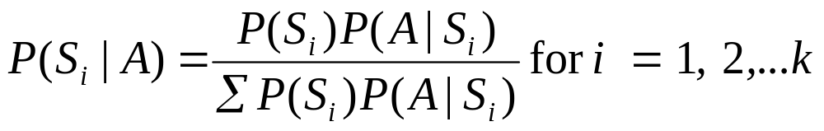
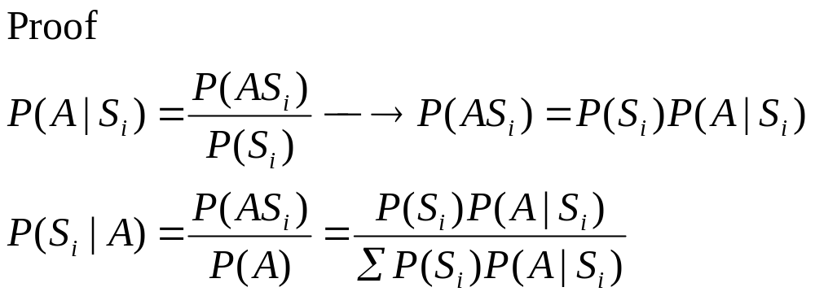
Bayes’ Rule
Let S₁ , S₂ , S₃ ,..., S_{k} be mutually exclusive and exhaustive events with prior probabilities P(S₁), P(S₂),…,P(S_{k}). If an event A occurs, the posterior probability of S_{i}, given that A occurred is

Slide 55
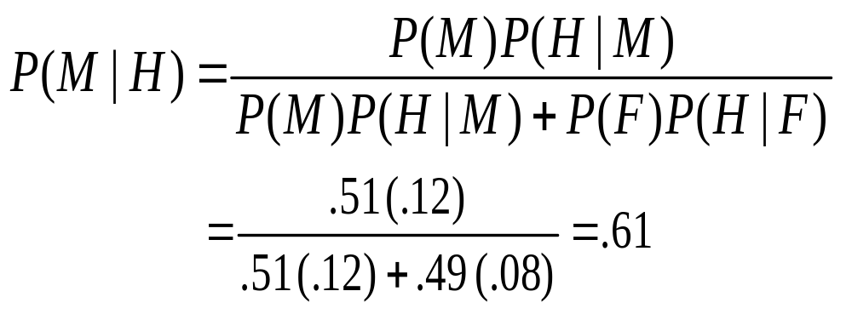
Example
From a previous example, we know that 49% of the population are female. Of the female patients, 8% are high risk for heart attack, while 12% of the male patients are high risk. A single person is selected at random and found to be high risk. What is the probability that it is a male?
Define H: high risk F: female M: male
We know:
P(F) =
P(M) =
P(H|F) =
P(H|M) =
.49
.51
.08
.12

Slide 56
Example
Suppose a rare disease infects one out of every 1000 people in a population. And suppose that there is a good, but not perfect, test for this disease: if a person has the disease, the test comes back positive 99% of the time. On the other hand, the test also produces some false positives: 2% of uninfected people are also test positive. And someone just tested positive. What are his chances of having this disease?

Slide 57

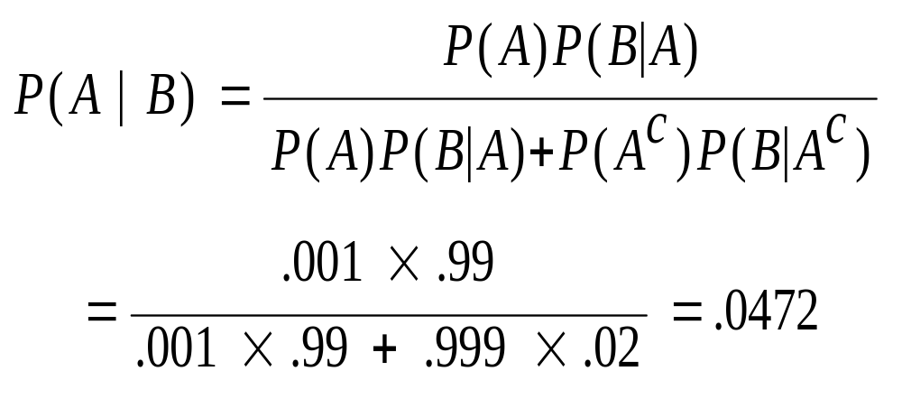
Example
Define A: has the disease B: test positive
We know:
P(A) = .001 P(A^{c}) =.999
P(B|A) = .99 P(B|A^{c}) =.02
We want to know P(A|B)=?

Slide 58
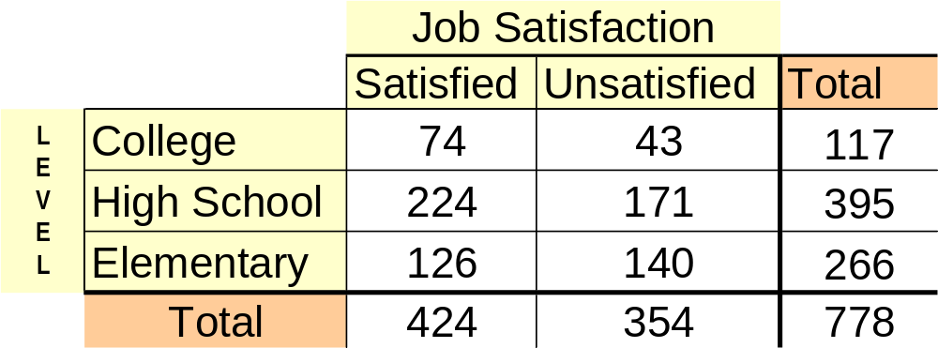
Example
A survey of job satisfaction² of teachers was taken, giving the following results
² “Psychology of the Scientist: Work Related Attitudes of U.S. Scientists” (Psychological Reports (1991): 443 – 450).

Slide 59
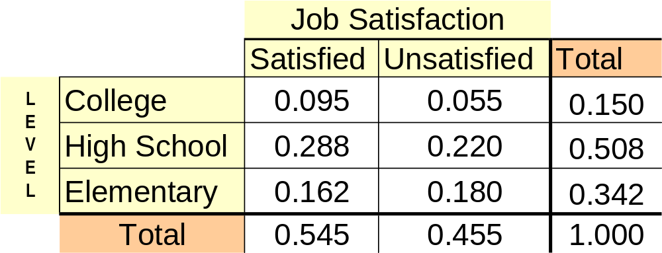
Example
If all the cells are divided by the total number surveyed, 778, the resulting table is a table of empirically derived probabilities.

Slide 60
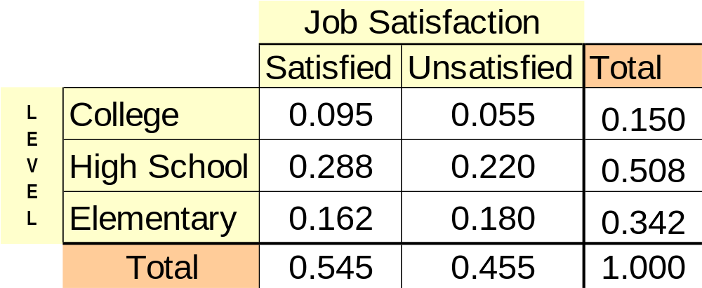



Example
For convenience, let C stand for the event that the teacher teaches college, S stand for the teacher being satisfied and so on. Let’s look at some probabilities and what they mean.
is the proportion of teachers who are college teachers.
is the proportion of teachers who are satisfied with their job.
is the proportion of teachers who are college teachers and who are satisfied with their job.

Slide 61
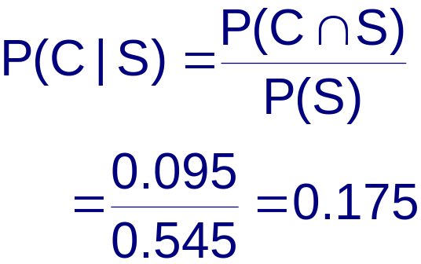
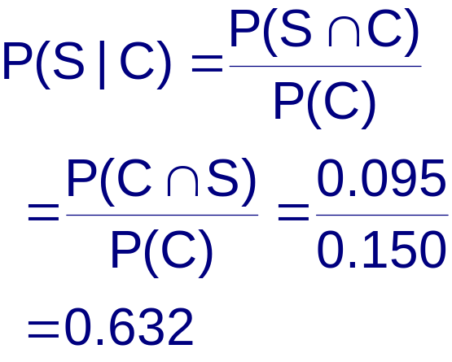
Example
is the proportion of teachers who are college teachers given they are satisfied. Restated: This is the proportion of satisfied that are college teachers.
is the proportion of teachers who are satisfied given they are college teachers. Restated: This is the proportion of college teachers that are satisfied.

Slide 62
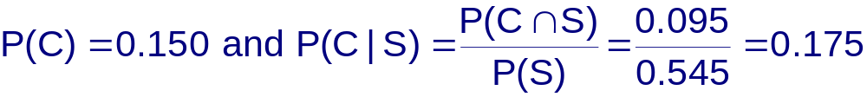
Example
Are C and S independent events?
P(C|S) ≠ P(C) so C and S are dependent events.

Slide 63

Example
P(CS)?
P(C) = 0.150, P(S) = 0.545 and
P(CS) = 0.095, so
P(CS) = P(C)+P(S) - P(CS)
= 0.150 + 0.545 - 0.095
= 0.600

Slide 64

Example
Tom and Dick are going to take
a driver's test at the nearest DMV office. Tom estimates that his chances to pass the test are 70% and Dick estimates his as 80%. Tom and Dick take their tests independently.
Define D = {Dick passes the driving test}
T = {Tom passes the driving test}
T and D are independent.
P (T) = 0.7, P (D) = 0.8

Slide 65
Example
What is the probability that at most one of the two friends will pass the test?
P(At most one person pass)
= P(D^{c} ∩ T^{c}) + P(D^{c} ∩ T) + P(D ∩ T^{c})
= (1 - 0.8) (1 – 0.7) + (0.7) (1 – 0.8) + (0.8) (1 – 0.7)
= .44
P(At most one person pass)
= 1-P(both pass) = 1- 0.8 x 0.7 = .44

Slide 66
Example
What is the probability that at least one of the two friends will pass the test?
P(At least one person pass)
= P(D ∪ T)
= 0.8 + 0.7 - 0.8 x 0.7
= .94
P(At least one person pass)
= 1-P(neither passes) = 1- (1-0.8) x (1-0.7) = .94

Slide 67
Example
Suppose we know that only one of the two friends passed the test. What is the probability that it was Dick?
P(D | exactly one person passed)
= P(D ∩ exactly one person passed) / P(exactly one person passed)
= P(D ∩ T^{c}) / (P(D ∩ T^{c}) + P(D^{c} ∩ T) )
= 0.8 x (1-0.7)/(0.8 x (1-0.7)+(1-.8) x 0.7)
= .63

Slide 68
Random Variables
A quantitative variable x is a random variable if the value that it assumes, corresponding to the outcome of an experiment is a chance or random event.
Random variables can be discrete or continuous.
Examples:
  x = SAT score for a randomly selected student
  x = number of people in a room at a randomly selected time of day
  x = number on the upper face of a randomly tossed die

Slide 69
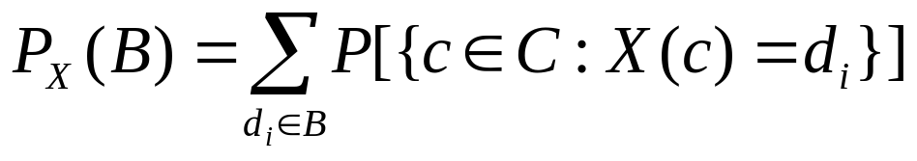
Random Variables
Consider a random experiment with a sample space C. A function X which assigns to each element c (c belongs to the sample space) one and only one number X(c) = x, is a random variable.
Notation:
  B: any event
  D: a new sample space
  {d_{i} }:simple events which belong to D

Slide 70
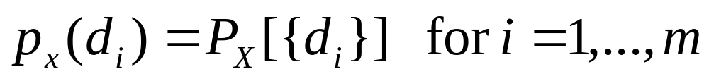
PMF
Here P_{x} is completely determined by the function
The function p_{x} (d_{i} ) is called the probability mass function (pmf).
Example: Write the pmf for X: sum of the upfaces on a roll of a pair of 6-sideddice.
Compute probability for event B={x: x=7,11}

Slide 71

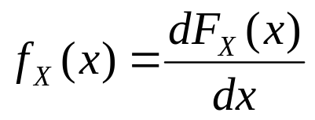
Cumulative Distribution Function
Let X be a random variable. Then its cdf is defined as
Continuing with the previous example, define the cdf of X.
For a continuous random variable, the probability density function can be obtained as

Slide 72

Note
If X and Y are two random variables and F_{X}(x)=F_{y} (y) for all x in R, then X and Y are equal in distribution and it is denoted as
Though X and Y may be equal in distribution, X and Y itself may be quite different.
See example in book.

Slide 73
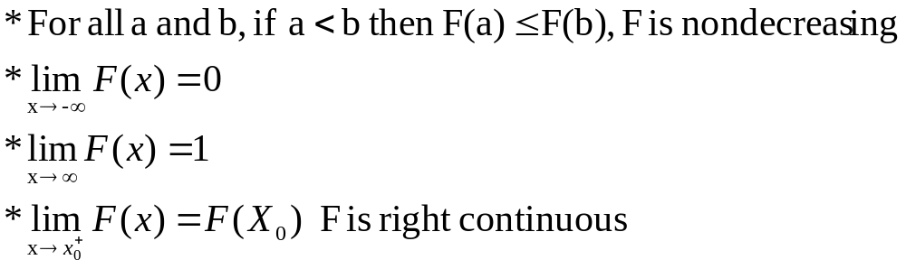
Theorems
Let X be a random variable with cumulative distribution function F(x). Then
Let X be a rv with cdf F_{x} . Then for a < b, P[a<X≤b]=F_{x} (b)-F_{x} (a)

Slide 74
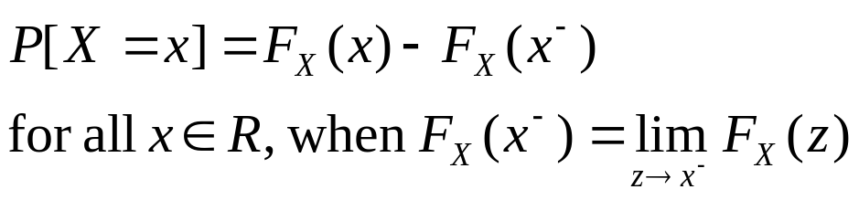
Theorem
For any random variable
Lets work through the proof.

Slide 75
DISCRETE RANDOM VARIABLES
We say a random variable is a discrete rv if its space is either finite or countable.
Example:
  Consider a sequence of independent flips of a count. Let X be the number of flips required to obtain the first head. What is the pmf for X?
  Five fuses are chosen from a lot of 100 fuses. The lot contains 20 defective fuses. Let X be the number of non-defective fuses, what is the pmf for X?

Slide 76
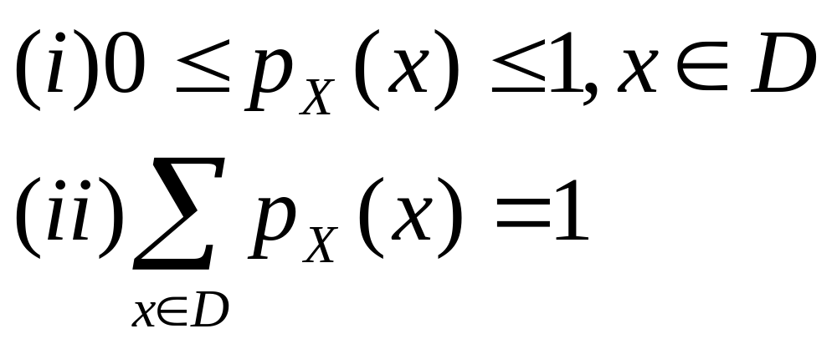
Properties of pmf

Slide 77
Transformations
Suppose we are interested in some random variable Y, which is some transformation of X, say Y=g(X). Assume X is discrete with space D_{x.}
Then the space of Y is D_{y} ={g(x);x belongs to D_{x} }.
Y can be obtained as

Slide 78
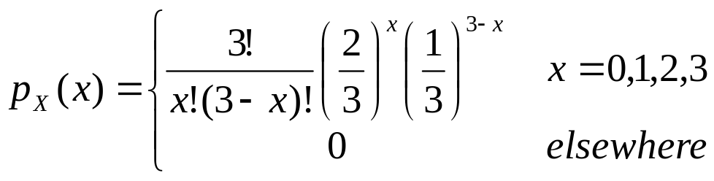
Example
Let X have the pmf
Find the pmf of Y where Y = X²

Slide 79
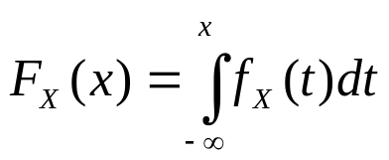
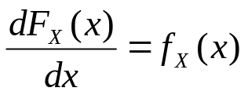
CONTINUOUS RANDOM VARIABLE
We say a random variable is a continuous random variable if its cumulative distribution function is a continuous function for all x belong to R.
We define the cdf as
The probability density function can be defined as

Slide 80
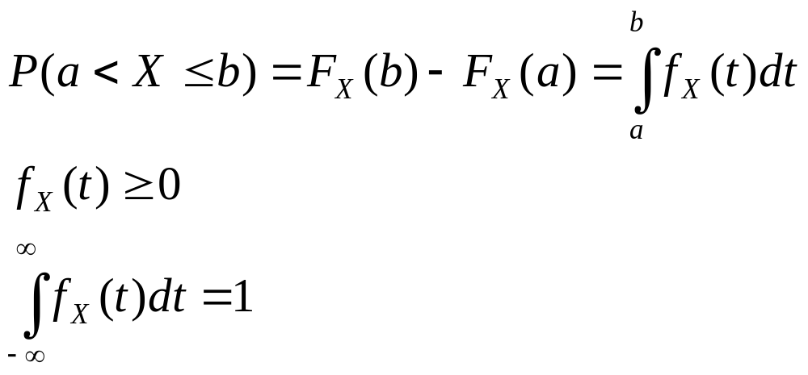
Note

Slide 81
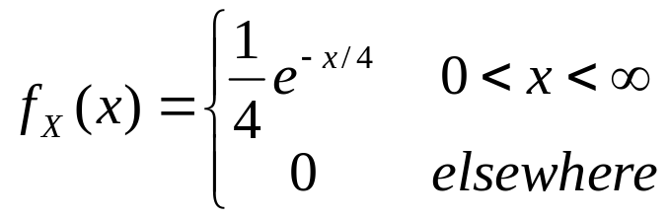
Example
Let the random variable be the time in seconds between incoming telephone calls at a busy switchboard. Suppose that a reasonable pdf for X is given below. Find P(X>4).

Slide 82
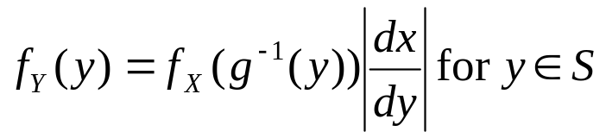
Transformation
Let X be a continuous random variable with pdf f_{X} (x) and support S. Let Y =g(X), where g(x) is a one-to-one differentiable function, on the support of X, S. Denote the inverse of g by x=g⁻¹ (y) and let dx/dy =d[g⁻¹ (y)]/dy. Then the pdf of Y is given by
Notes:
The dx/dy is called the Jacobian and is denoted by J

Slide 83
Example
Let X have the pdf given below. Find the pdf for Y where Y=-2logX.
  f(x)=1 for 0<x<1

Slide 84

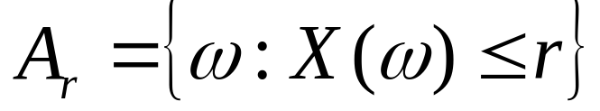
Definition of random variable (RV)
For a given probability space ( ,A, P[⋅]), a random variable, denoted by X or X(⋅), is a function with domain Ω and counterdomain the real line. The function X(⋅) must be such that the set A_{r}, denoted by , belongs to A for every real number r.

Slide 85
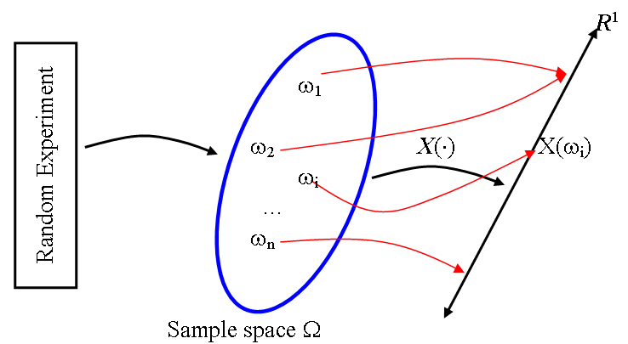

Slide 86
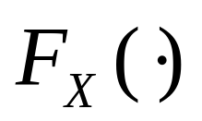
Cumulative distribution function (CDF)
The cumulative distribution function of a random variable X, denoted by , is defined to be

Slide 87
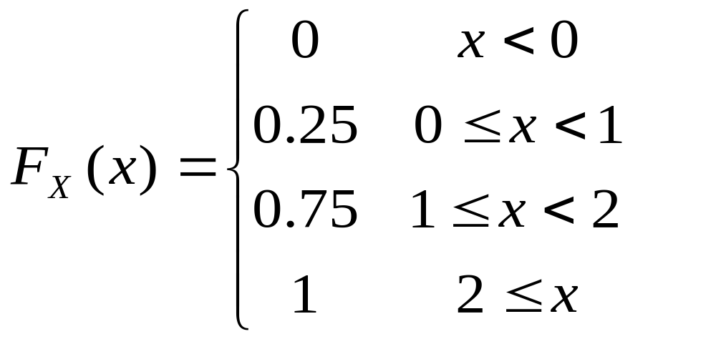
Consider the experiment of tossing two fair coins. Let random variable X denote the number of heads. CDF of X is

Slide 88
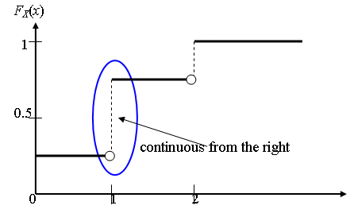

Slide 89
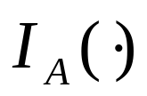
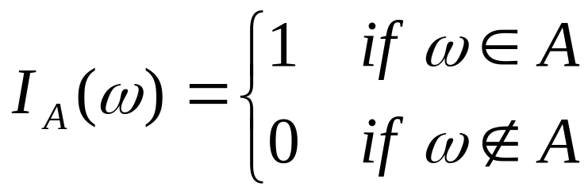
Indicator function or indicator variable
Let Ω be any space with points ω and A any subset of Ω. The indicator function of A, denoted by , is the function with domain Ω and counterdomain equal to the set consisting of the two real numbers 0 and 1 defined by

Slide 90
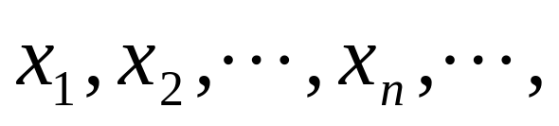
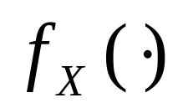
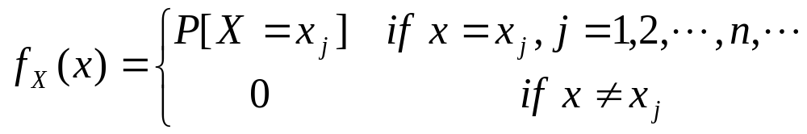
Discrete random variables
A random variable X will be defined to be discrete if the range of X is countable.
If X is a discrete random variable with values
then the function denoted by
and defined by
is defined to be the discrete density function of X.

Slide 91

Continuous random variables
A random variable X will be defined to be continuous if there exists a function such that for every real number x.
The function is called the probability density function of X.

Slide 92





Properties of a CDF
is continuous from the right, i.e.

Slide 93


Properties of a PDF

Slide 94



Example 1
Determine which of the following are valid distribution functions:

Slide 95


Slide 96


Slide 97

Example 2
Determine the real constant a, for arbitrary real constants m and 0 < b, such that
is a valid density function.

Slide 98


Function is symmetric about m.

Slide 99
Characterizing random variables
Cumulative distribution function
Probability density function
  Expectation (expected value)
  Variance
  Moments
  Quantile
  Median
  Mode

Slide 100


Expectation of a random variable
The expectation (or mean, expected value) of X, denoted by or E(X) , is defined by:

Slide 101

Rules for expectation
Let X and X_{i} be random variables and c be any real constant.

Slide 102

Variance of a random variable

Slide 103

is called the standard deviation of X.

Slide 104

Rules for variance

Slide 105

Two random variables are said to be independent if knowledge of the value assumed by one gives no clue to the value assumed by the other.
Events A and B are defined to be independent if and only if

Slide 106

Moments and central moments of a random variable

Slide 107

Properties of moments

Slide 108


Slide 109




Quantile
The q^{th} quantile of a random variable X, denoted by , is defined as the smallest number satisfying .

Slide 110



Median and mode
The median of a random variable is the 0.5th quantile, or .
The mode of a random variable X is defined as the value u at which is the maximum of .

Slide 111
Note: For a positively skewed distribution, the mean will always be the highest estimate of central tendency and the mode will always be the Lowest estimate of central tendency (assuming that the distribution has only one mode). For negatively skewed distributions, the mean will always be the lowest estimate of central tendency and the mode will be the highest estimate of central tendency. In any skewed distribution (i.e., positive or negative) the median will always fall in-between the mean and the mode.

Slide 112

Moment generating function

Slide 113


Slide 114
Usage of MGF
MGF can be used to express moments in terms of PDF parameters and such expressions can again be used to express mean, variance, coefficient of skewness, etc. in terms of PDF parameters.
Random variables of the same MGF are associated with the same type of probability distribution.

Slide 115
The moment generating function of a sum of independent random variables is the product of the moment generating functions of individual random variables.

Slide 116

Expected value of a function of a random variable

Slide 117


If Y=g(X)

Slide 118

Y
Y=g(X)
Δy
Δx₁
X
Δx₂
Δx₃

Slide 119

Theorem

Slide 120

Chebyshev Inequality

Slide 121
The Chebyshev inequality gives a bound, which does not depend on the distribution of X, for the probability of particular events described in terms of a random variable and its mean and variance.

Slide 122
Probability density functions of discrete random variables
Discrete uniform distribution
Bernoulli distribution
Binomial distribution
Negative binomial distribution
Geometric distribution
Hypergeometric distribution
Poisson distribution

Slide 123

EXPECTATION OF A RANDOM VARIABLE
Let X be a random variable. If X is a continuous random variable with pdf f(x) and
Notes:
Similarly we can define the expectation for a discrete random variable.

Slide 124
Example for a discrete RV
Let the random variable X of the discrete type have the pmf given by the table below. Find E(X).
X | 1 | 2 | 3 | 4
P(X) | 4/10 | 1/10 | 3/10 | 2/10

Slide 125

Theorem
Expectation of a constant is a constant itself, that is E(k)=k.
Let X be a random variable and let Y=g(X) for some function g.
  Suppose X is continuous with pdf f(x).
Notes:
Again similar definition for discrete case, the series should converge

Slide 126
Theorem
Let g₁(X) and g₂(X) be the functions of a random variable X. Suppose the expectations of g₁(X) and g₂(X) exist. Then for any constants k₁ and k₂, the expectation of k₁ g₁(X) + k₂ g₂(X) exists and is given
  E[k₁ g₁(X) + k₂ g₂(X)]= k₁ E( g₁(X)) + k₂ E(g₂(X) )

Slide 127
SOME SPECIAL EXPECTATIONS
Some expectations have special names.
  E(X) is called the mean value of X.
  It is denoted by µ.
  The mean is the first moment (about 0) of a random variable.

Slide 128

Variance
Let X be a random variable with finite mean µ and such that E[(x- µ)²] is finite. Then the variance of X is defined to be E[(x- µ)²]. It is usually denoted by σ² or by Var(X).
  We can write
  Here σ is called the standard deviation of X.
    Measures the dispersion of the points in the space relative to the mean.
Notes:
Do proof for that

Slide 129
Moment Generating Function
Let X be a random variable such that h>0, the expectation of e^{tx} exists for –h < t < h. The moment generating function (mgf) of X is defined to be the function M(t)=E(e^{tx} ) for –h<t<h.
If X and Y have the same distribution, them they have the same mgf in a neighborhood of 0. The converse is also true.

Slide 130

Note

Slide 131

Probability Distributions for Discrete Random Variables
The probability distribution for a discrete random variable x resembles the relative frequency distributions we constructed in Chapter 2. It is a graph, table or formula that gives the possible values of x and the probability p(x) associated with each value.

Slide 132

Example
Toss a fair coin three times and define x = number of heads.
x
3
2
2
2
1
1
1
0
HHH
x | p(x)
0 | 1/8
1 | 3/8
2 | 3/8
3 | 1/8
1/8
1/8
1/8
1/8
1/8
1/8
1/8
1/8
P(x = 0) = 1/8
P(x = 1) = 3/8
P(x = 2) = 3/8
P(x = 3) = 1/8
HHT
HTH
THH
HTT
Probability Histogram for x
THT
TTH
TTT

Slide 133

Example
Toss two dice and define
x = sum of two dice.
x | p(x)
2 | 1/36
3 | 2/36
4 | 3/36
5 | 4/36
6 | 5/36
7 | 6/36
8 | 5/36
9 | 4/36
10 | 3/36
11 | 2/36
12 | 1/36

Slide 134
Probability Distributions
Probability distributions can be used to describe the population, just as we described samples in Chapter 2.
  Shape: Symmetric, skewed, mound-shaped…
  Outliers: unusual or unlikely measurements
  Center and spread: mean and standard deviation. A population mean is called μ and a population standard deviation is called σ.

Slide 135

The Mean and Standard Deviation
Let x be a discrete random variable with probability distribution p(x). Then the mean, variance and standard deviation of x are given as

Slide 136



Example
Toss a fair coin 3 times and record x the number of heads.
x | p(x) | xp(x) | (x-μ)²p(x)
0 | 1/8 | 0 | (-1.5)²(1/8)
1 | 3/8 | 3/8 | (-0.5)²(3/8)
2 | 3/8 | 6/8 | (0.5)²(3/8)
3 | 1/8 | 3/8 | (1.5)²(1/8)

Slide 137
Example
The probability distribution for x the number of heads in tossing 3 fair coins.
Symmetric; mound-shaped
Shape?
Outliers?
Center?
Spread?
None
μ = 1.5
σ = .688
μ

Slide 138
Key Concepts
I. Experiments and the Sample Space
1. Experiments, events, mutually exclusive events,
simple events
2. The sample space
II. Probabilities
1. Relative frequency definition of probability
2. Properties of probabilities
a. Each probability lies between 0 and 1.
b. Sum of all simple-event probabilities equals 1.
3. P(A), the sum of the probabilities for all simple events in A

Slide 139

Key Concepts
III. Counting Rules
1. mn Rule; extended mn Rule
2. Permutations:
3. Combinations:
IV. Event Relations
1. Unions and intersections
2. Events
a. Disjoint or mutually exclusive: P(A ∩ B) = 0
b. Complementary: P(A) = 1 − P(A^{C} )

Slide 140



Key Concepts
3. Conditional probability:
4. Independent and dependent events
5. Additive Rule of Probability:
6. Multiplicative Rule of Probability:
7. Law of Total Probability
8. Bayes’ Rule

Slide 141



Key Concepts
V. Discrete Random Variables and Probability Distributions
1. Random variables, discrete and continuous
2. Properties of probability distributions
3. Mean or expected value of a discrete random variable:
4. Variance and standard deviation of a discrete random variable:

